Slide 1
TASK MANAGEMENT
UNDER THE GUIDANCE OF :
POOJA MEHTA MAAM
SUBMITTED BY:
1. Jitendra Patil
2. Sankit Hathyani
3. Krish Ballal

Slide 2
INTRODUCTION
The Task Management Project has been developed on AngularJS, NodeJS and MySQL. We are providing AngularJS projects with source code, database, and documentation. Task Management major project is an application which is based on managing the tasks. This application is very simple and impressive. The main objective behind this AngularJS
application Task management project is to provide all the details about ongoing tasks.
There is a single role user in this project who can manage the activity. User can add the new task and Task description and also update and delete the task. This AngularJS major project is very helpful for maintain the task data because it is very complex task to manage the daily working Projects updates. In this project user can see the details of all the tasks.

Slide 3
TECHNOLOGY USED
JAVA
Java is an object-oriented programming (OOP) language, which means it supports the principles and concepts of object-oriented programming.
JaVa
HTML
angular
HTML, which stands for HyperText Markup Language, is the standard markup language used for creating and structuring web pages.
ANGULAR
Angular is a TypeScript-based framework that uses HTML, CSS, and JavaScript to build robust and scalable single-page applications.
Postman
POSTMAN
JAVASCRIPT
Postman is a popular collaboration platform and toolset used by developers to build, test, and document APIs
JavaScript is a widely used programming language primarily used for web development.

Slide 4
PROPOSED SYSTEM
The platform for users to browse proposed system of an online and get updates of ongoing tasks and Todo list to provide a seamless and user-friendly, create and update the tasks conveniently from the comfort of their homes.
Given comprehensive full-stack project combines the power of Java Spring Boot, Hibernate, MySQL, and Angular. This system aims to address the challenges of modern web development by utilizing Java Spring Boot for rapid backend development, Hibernate for seamless communication with the MySQL database, and Angular for creating dynamic and interactive user interfaces. By leveraging these technologies, we can deliver a robust, scalable, and user-friendly application that meets the demands of today's web development landscape.

Slide 5
REQUIRED SPECIFICATIONS
HARDWARE CONFIGURATION | SOFTWARE CONFIGURATION
Operating System : Windows 10 and above | Software IDE: Eclipse, Postman, MySQL, VS Code.
Hard Disk: 500 GB | Language: JAVA, Type Script, HTML, CSS
RAM: 8 GB | Front End: Angular, Boot Strap
 | Back End: Spring Boot, MySQL.

Slide 6
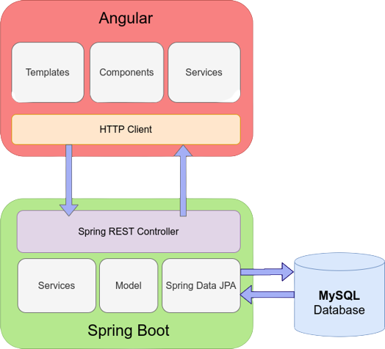
CONNECTION TO DATABASE

Slide 7
MODULES
01
REGISTER :
Registration and Login.
02
USER :
Sign Up and Login.
03
ADD TASK:
Add/Update/Delete tasks by user.
04
SEARCH TEXT :
User can Search the task in search bar
05
LOGOUT :
Logout form the Dashboard.

Slide 8
SPRING NOTATATIONS
@Controller : | The @Controller annotation indicates that a particular class serves the role of a controller. Spring Controller annotation is typically used in combination with annotated handler methods based on the @RequestMapping annotation.
@Autowired | The @Autowired annotation provides more fine-grained control over where and how auto-wiring should be accomplished. Autowiring feature of spring framework enables you to inject the object dependency implicitly. It internally uses setter or constructor injection.
@RequestMapping | The @RequestMapping is one of the most common annotation used in Spring Web applications. This annotation maps HTTP requests to handler methods of MVC and REST controllers.
@Entity | The @Entity annotation specifies that the class is an entity and is mapped to a database table.
@Table | The @Table annotation is used to create a table in database.
@JoinColumn | The @JoinColumn is used to specify a column for joining an entity association or element collection.

Slide 9
SPRING NOTATATIONS
@PutMapping | The @PutMapping is used for update the records.
@PostMapping | The @PostMapping is used to create a resource Mapping.
@GetMapping | The @GetMapping is used to read all the inserted records.
@DeleteMapping | The @DeleteMapping is used to delete the records.
@PathVariable | The @Path Variable annotation is used to extract the value from the URL.
@RequestParam | The @RequestParam annotation is used to read the form data and bind it automatically to the parameter present in the provided method.

Slide 10
SPRING NOTATATIONS
@Request Body | The @RequestBody annotation is applicable to handler methods of spring controller. spring should deserialize a request body into an object.
@OneToOne Mapping | The @OneToOne JPA annotation is used to map the source entity with the target entity, Hibernate maps the tables in your database to the Entity classes in your application.
@OneToMany Mapping | The @OneTo-Many relationship between table A and table B indicates that one row in a table A link to many rows in table B but one row in table B links to only one row in table A.
@ManyToOne Mapping | The @Many-to-One mapping means that many instances of this entity are mapped to one instance of another entity.
@ExceptionHandler | The @ExceptionHandler is an annotation used to handle the specific exceptions and sending the custom responses to the client.
@ControllerAdvice | A controller advice allows you to use exactly the same exception handling techniques but apply them across the whole application, not just to an individual controller. You can think of them as an annotation driven interceptor.

Slide 11
ADVANTAGES
Clear Progress Tracking
Enhanced Productivity
Provides visual tools like charts and status updates to monitor task completion and identify bottlenecks in real-time.
Organizes tasks efficiently, helping users prioritize and complete them on time, reducing delays and improving workflow.
Deadline Management
Improved
Collaboration
Keeps users informed with reminders and alerts for approaching deadlines, minimizing missed tasks and ensuring timely delivery.
Facilitates seamless communication and task delegation among team members, ensuring better teamwork and coordination.

Slide 12
CONCLUSION
The Task Management Project is a powerful tool designed to streamline task organization, enhance team collaboration, and ensure timely completion of work.
By providing features like add task, progress tracking, updates/delete task and deadline reminders, it boosts productivity and simplifies project management, making it an essential solution for individuals and teams.
Using Java and the latest technologies, it offers robust performance, scalability, and security. By providing features like task prioritization, progress tracking, and deadline reminders, it boosts productivity and simplifies project management, making it an essential solution for individuals and teams.

Slide 13
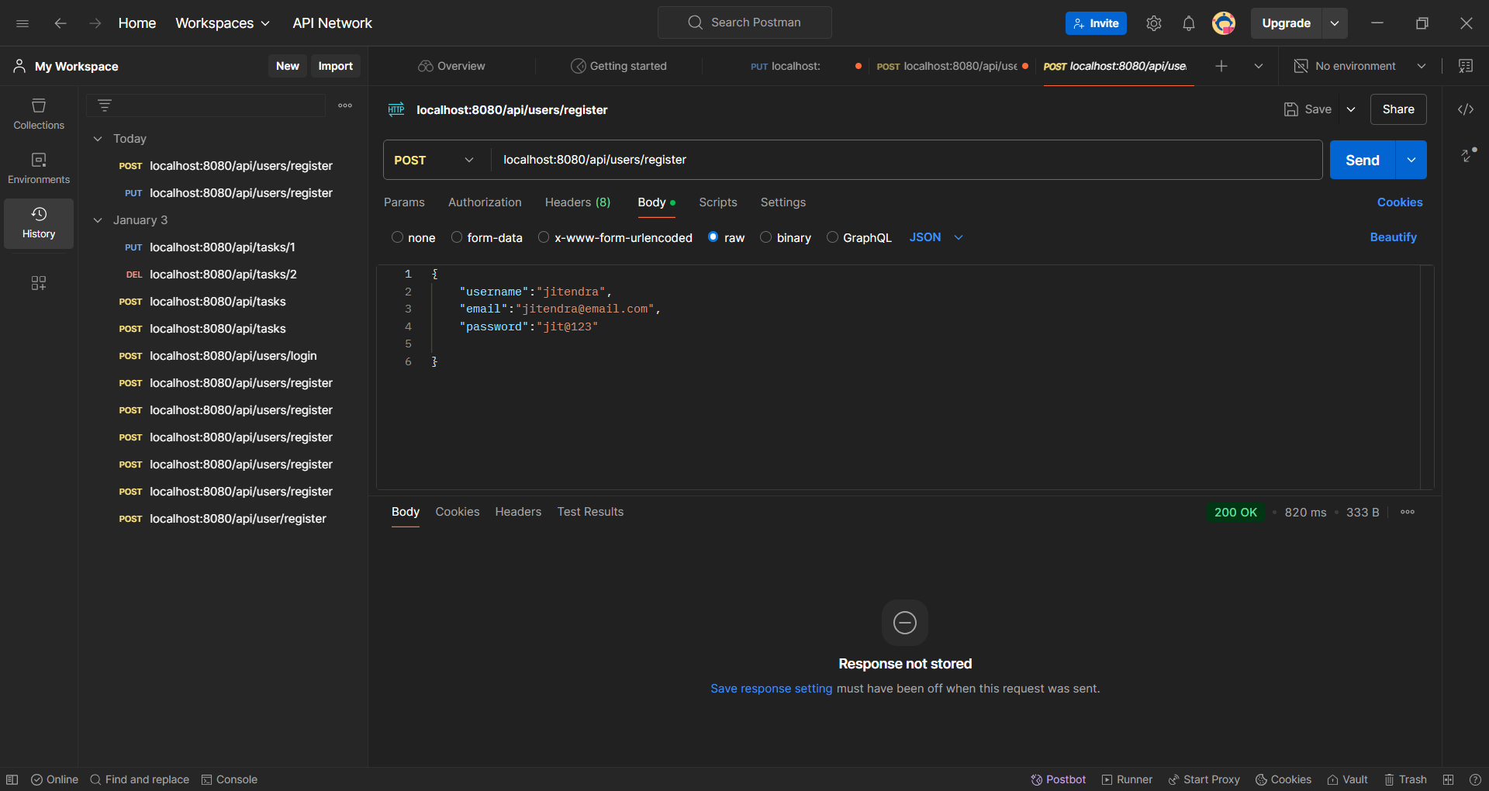
ADMIN REGISTRATION FROM POSTMAN

Slide 14
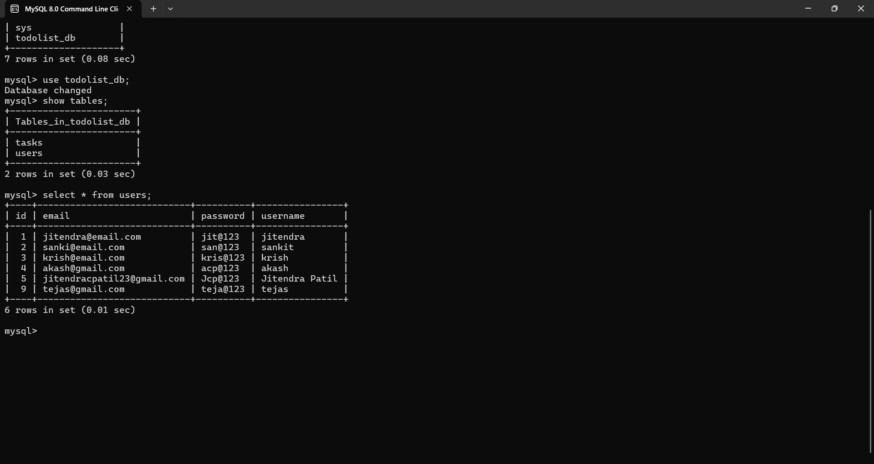
USERS TABLE

Slide 15
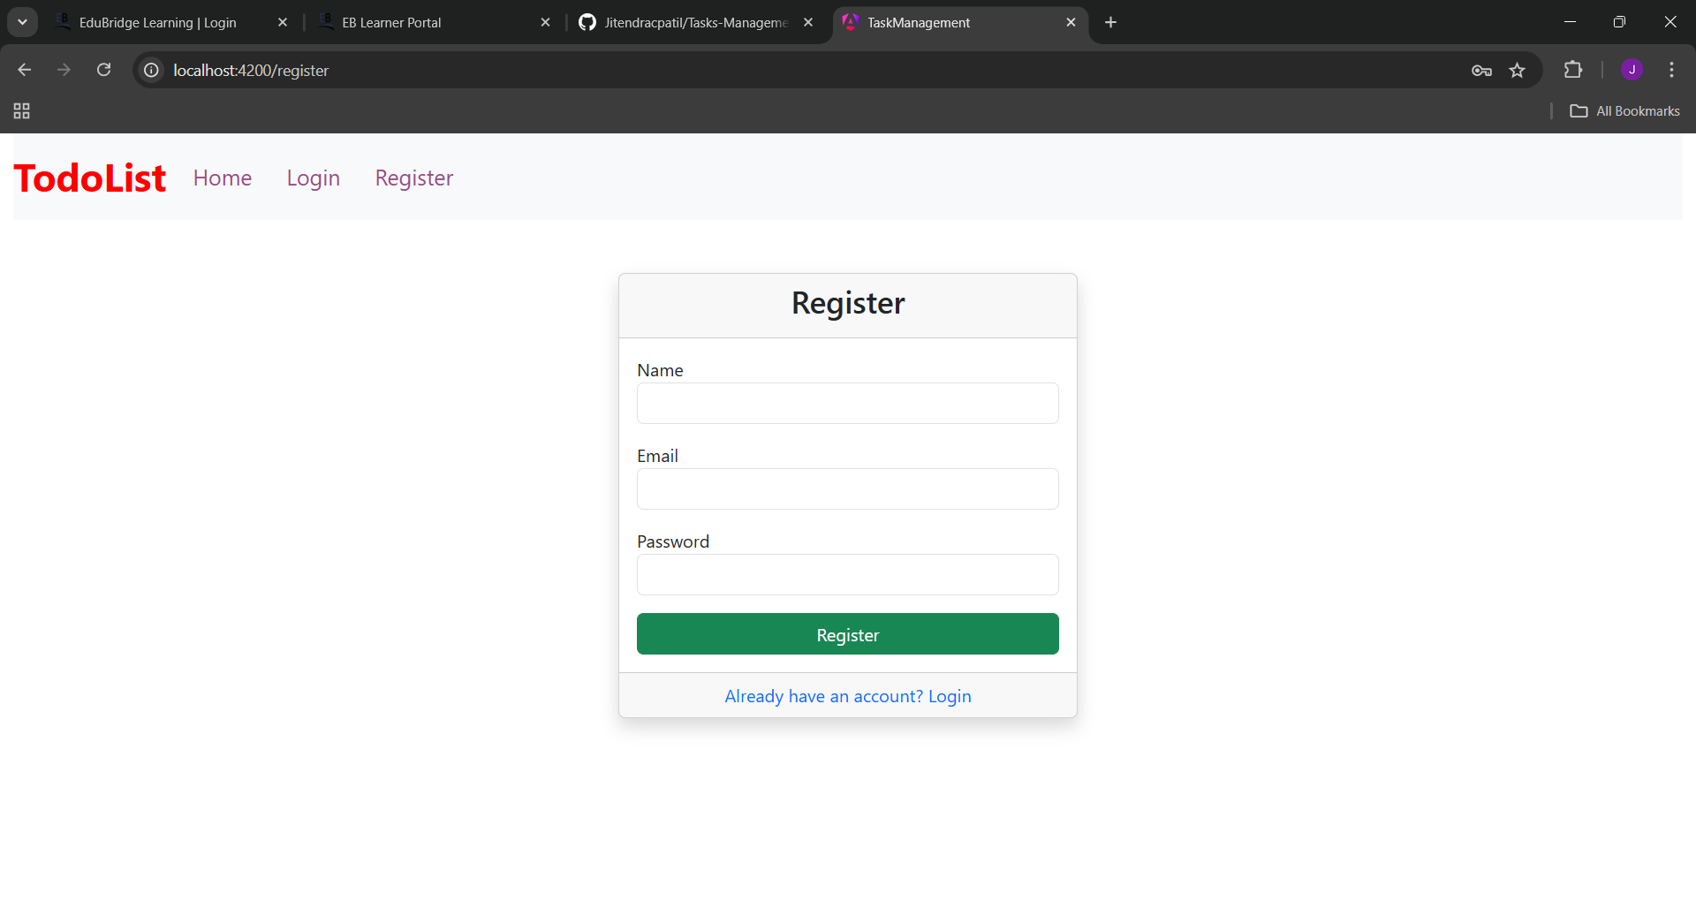
USER REGISTRATION

Slide 16
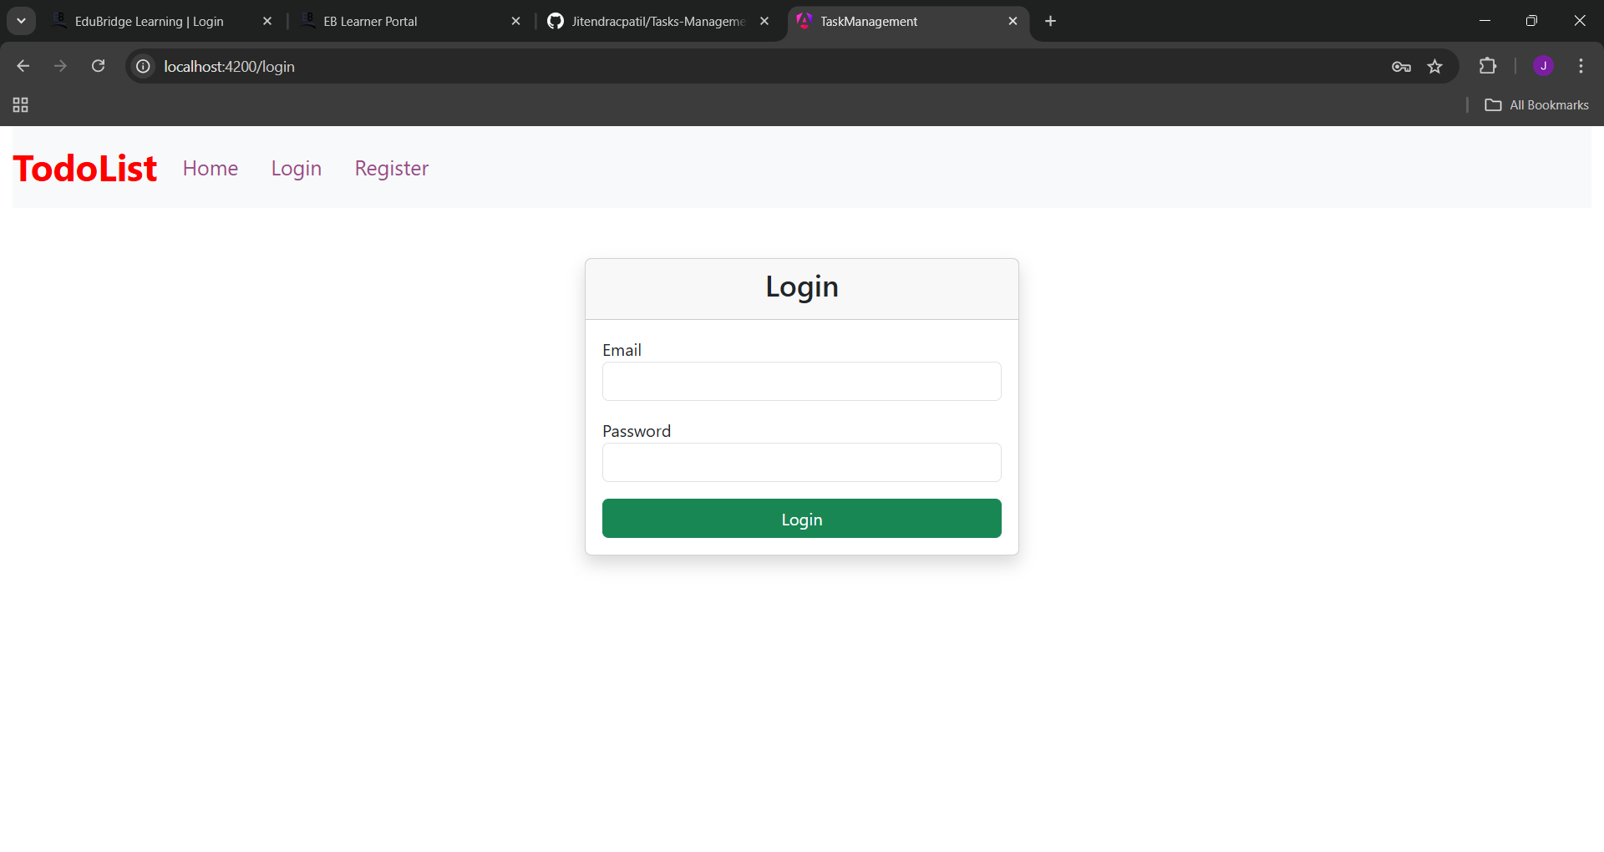
USER LOGIN

Slide 17
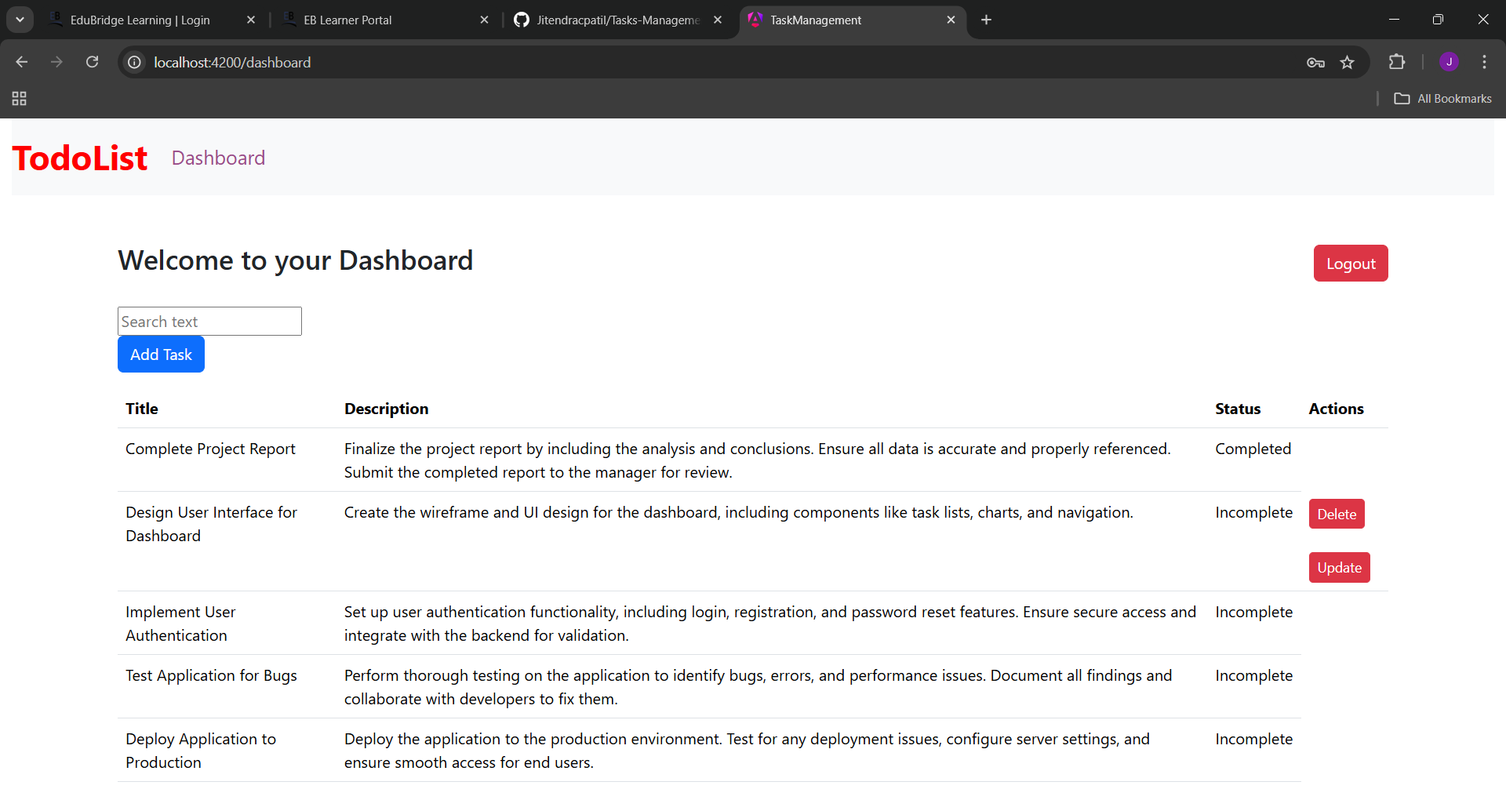
DASHBOarD

Slide 18
THANK YOU

